Slide 1
Graphs – ADTs and Implementations
1843
ORD
SFO
802
337
1743
LAX
1233
DFW

Slide 2
Applications of Graphs
Electronic circuits
Printed circuit board
Integrated circuit
Transportation networks
Highway network
Flight network
Computer networks
Local area network
Internet
Web
Databases
Entity-relationship diagram

Slide 3
Outline
Definitions
Graph ADT
Implementations

Slide 4
Outline
Definitions
Graph ADT
Implementations

Slide 5
Edge Types
Directed edge
ordered pair of vertices (u,v)
first vertex u is the origin
second vertex v is the destination
e.g., a flight
Undirected edge
unordered pair of vertices (u,v)
e.g., a flight route
Directed graph (Digraph)
all the edges are directed
e.g., route network
Undirected graph
all the edges are undirected
e.g., flight network
flight
AA 1206
ORD
PVD
849
miles
ORD
PVD

Slide 6
Vertices and Edges
End vertices (or endpoints) of an edge
U and V are the endpoints of a
Edges incident on a vertex
a, d, and b are incident on V
Adjacent vertices
U and V are adjacent
Degree of a vertex
X has degree 5
Parallel edges
h and i are parallel edges
Self-loop
j is a self-loop
V
a
b
h
j
U
d
X
Z
c
e
i
W
g
f
Y

Slide 7
Graphs
A graph is a pair (V, E), where
V is a set of nodes, called vertices
E is a collection of pairs of vertices, called edges
Vertices and edges are positions and store elements
Example:
A vertex represents an airport and stores the three-letter airport code
An edge represents a flight route between two airports and stores the mileage of the route
849
PVD
1843
ORD
142
SFO
802
LGA
337
1743
1387
HNL
2555
1099
LAX
1233
DFW
1120
MIA

Slide 8
Paths
Path
sequence of alternating vertices and edges
begins with a vertex
ends with a vertex
each edge is preceded and followed by its endpoints
Simple path
path such that all its vertices and edges are distinct
Examples
P₁=(V,b,X,h,Z) is a simple path
P₂=(U,c,W,e,X,g,Y,f,W,d,V) is a path that is not simple
V
a
b
P₁
d
U
X
Z
P₂
h
c
e
W
g
f
Y

Slide 9
Cycles
Cycle
circular sequence of alternating vertices and edges
each edge is preceded and followed by its endpoints
Simple cycle
cycle such that all its vertices and edges are distinct
Examples
C₁=(V,b,X,g,Y,f,W,c,U,a,V) is a simple cycle
C₂=(U,c,W,e,X,g,Y,f,W,d,V,a,U) is a cycle that is not simple
V
a
b
d
U
X
Z
C₂
h
e
C₁
c
W
g
f
Y

Slide 10
Subgraphs
A subgraph S of a graph G is a graph such that
The vertices of S are a subset of the vertices of G
The edges of S are a subset of the edges of G
A spanning subgraph of G is a subgraph that contains all the vertices of G
Subgraph
Spanning subgraph

Slide 11
Connectivity
A graph is connected if there is a path between every pair of vertices
A connected component of a graph G is a maximal connected subgraph of G
Connected graph
Non connected graph with two connected components

Slide 12
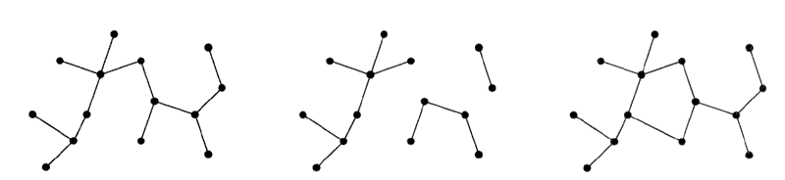
Trees
Tree
Forest
Graph with Cycle
A tree is a connected, acyclic, undirected graph.
A forest is a set of trees (not necessarily connected)

Slide 13
Spanning Trees
A spanning tree of a connected graph is a spanning subgraph that is a tree
A spanning tree is not unique unless the graph is a tree
Spanning trees have applications to the design of communication networks
A spanning forest of a graph is a spanning subgraph that is a forest
Graph
Spanning tree

Slide 14
Reachability in Directed Graphs
A node w is reachable from v if there is a directed path originating at v and terminating at w.
E is reachable from B
B is not reachable from E
E
D
C
F
A
B

Slide 15
Properties
Property 1
Σ_{v} deg(v) = 2|E|
Proof: each edge is counted twice
Property 2
In an undirected graph with no self-loops and no multiple edges
|E| ≤ |V| (|V| − 1)/2
Proof: each vertex has degree at most (|V| – 1)
Notation
|V| number of vertices
|E| number of edges
deg(v) degree of vertex v
Example
|V| = 4
|E| = 6
deg(v) = 3
Q: What is the bound for a digraph?

Slide 16
Outline
Definitions
Graph ADT
Implementations

Slide 17
Main Methods of the (Undirected) Graph ADT
Vertices and edges
are positions
store elements
Accessor methods
endVertices(e): an array of the two endvertices of e
opposite(v, e): the vertex opposite to v on e
areAdjacent(v, w): true iff v and w are adjacent
replace(v, x): replace element at vertex v with x
replace(e, x): replace element at edge e with x
Update methods
insertVertex(o): insert a vertex storing element o
insertEdge(v, w, o): insert an edge (v,w) storing element o
removeVertex(v): remove vertex v (and its incident edges)
removeEdge(e): remove edge e
Iterator methods
incidentEdges(v): edges incident to v
vertices(): all vertices in the graph
edges(): all edges in the graph

Slide 18
Directed Graph ADT
Additional methods:
isDirected(e): return true if e is a directed edge
insertDirectedEdge(v, w, o): insert and return a new directed edge with origin v and destination w, storing element o

Slide 19
Outline
Definitions
Graph ADT
Implementations

Slide 20
Running Time of Graph Algorithms
Running time often a function of both |V| and |E|.
For convenience, we sometimes drop the | . | in asymptotic notation, e.g. O(V+E).

Slide 21
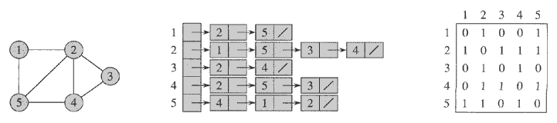
Implementing a Graph (Simplified)
Adjacency List
Adjacency Matrix

Slide 22
Representing Graphs (Details)
Three basic methods
Edge List
Adjacency List
Adjacency Matrix

Slide 23
Edge List Structure
Vertex object
element
reference to position in vertex sequence
Edge object
element
origin vertex object
destination vertex object
reference to position in edge sequence
Vertex sequence
sequence of vertex objects
Edge sequence
sequence of edge objects
u
a
c
b
d
v
w
z
u
v
w
z
a
b
c
d

Slide 24
Adjacency List Structure
Edge list structure
Incidence sequence for each vertex
sequence of references to edge objects of incident edges
Augmented edge objects
references to associated positions in incidence sequences of end vertices
a
v
b
u
w
u
v
w
a
b

Slide 25
Adjacency Matrix Structure
Edge list structure
Augmented vertex objects
Integer key (index) associated with vertex
2D-array adjacency array
Reference to edge object for adjacent vertices
Null for non- nonadjacent vertices
a
v
b
u
w
0
u
1
v
2
w
 | 0 | 1 | 2
0 | Ø |  | Ø
1 |  | Ø
2 | Ø |  | Ø
a
b

Slide 26
Asymptotic Performance (assuming collections V and E represented as doubly-linked lists)
|V| vertices, |E| edges no parallel edges no self-loops Bounds are “big-Oh” | Edge List | Adjacency List | Adjacency Matrix
Space | |V|+|E| | |V|+|E| | |V|²
incidentEdges(v) | |E| | deg(v) | |V|
areAdjacent (v, w) | |E| | min(deg(v), deg(w)) | 1
insertVertex(o) | 1 | 1 | |V|²
insertEdge(v, w, o) | 1 | 1 | 1
removeVertex(v) | |E| | deg(v) | |V|²
removeEdge(e) | 1 | 1 | 1

Slide 27
Outline
Definitions
Graph ADT
Implementations

